Slide 1
HEART DISEASE PREDICTION BY USING ML
Presented To
Dr. Ahmedul Kabir
Assistant Professor
Dept. of ECE
North South University
Presented By
Anik Kumar Majumdar
ID:1811954042
Course: CSE440
Sec-01

Slide 2
TABLE OF CONTENTS
01
04
02
05
03
06
Importing necessary libraries
Splitting the features and target
Model training and model evaluation
Data Loading, Processing, and Checking Dataset info
Building a predictive system and checking the results
Statiscal measures about the data

Slide 3
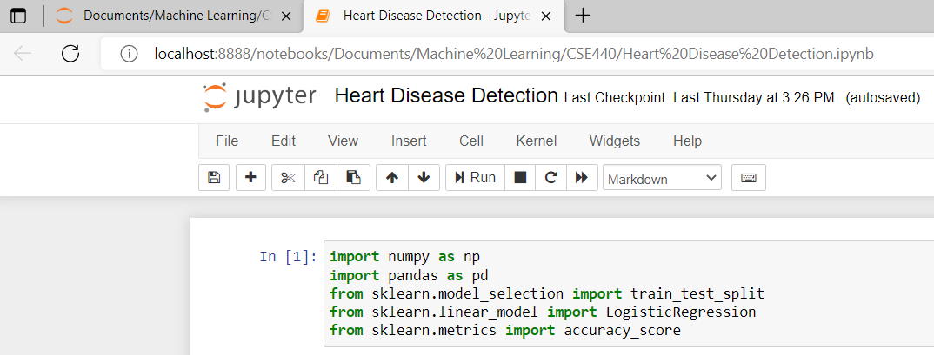
01
Importing necessary libraries

Slide 4
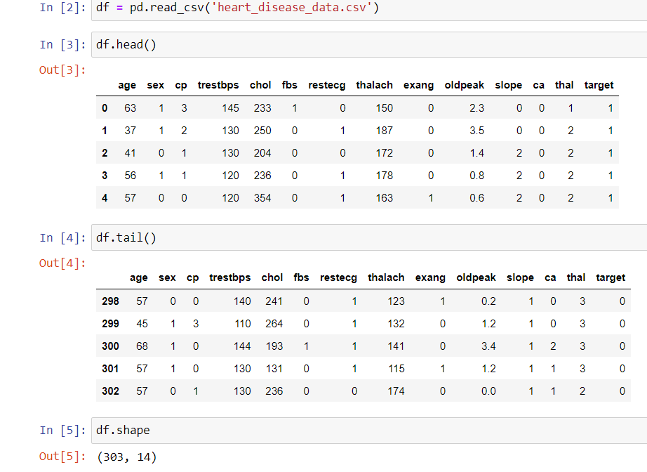
Data Loading, Processing, and Checking Dataset info
02
Figure: Data Loading and Checking the dimension of the dataset

Slide 5
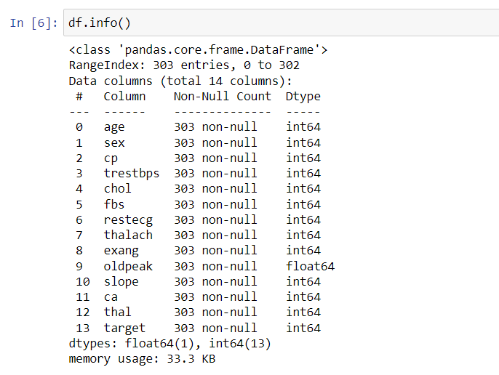
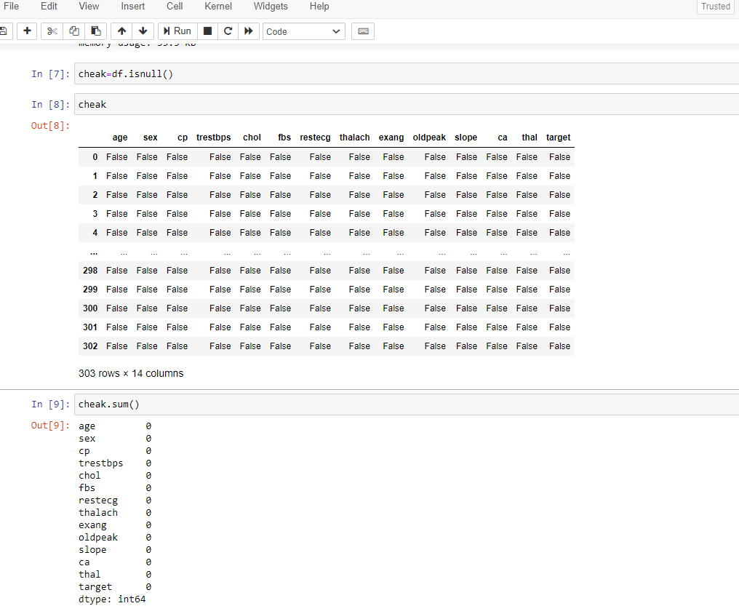
02
Data Loading, Processing, and Checking Dataset info continue…
Figure: Checking the dataset’s info
Figure: Checking null value and count them

Slide 6
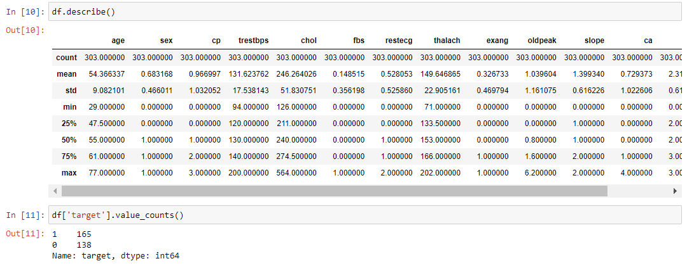
Statistical measures of the dataset
03

Slide 7
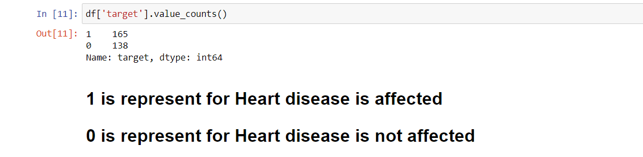
Statistical measures of the dataset conti…
03

Slide 8
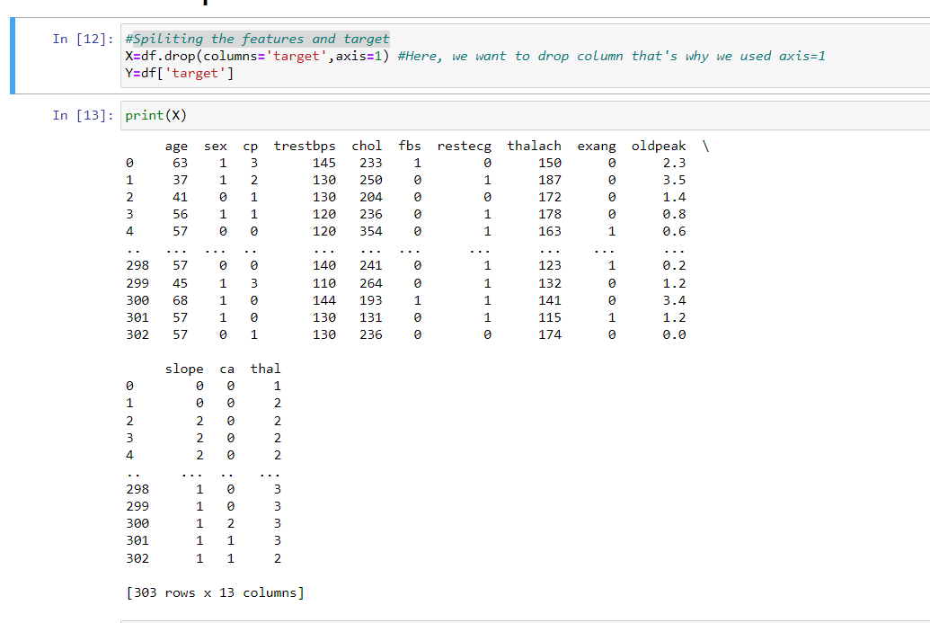
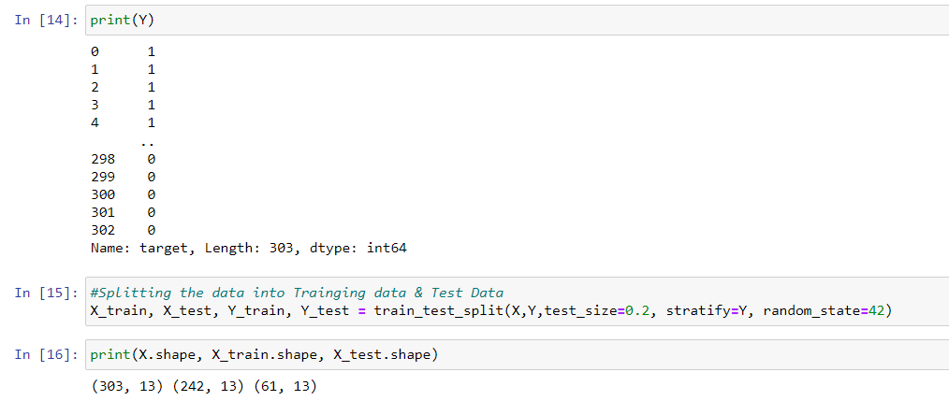
Splitting the features and target
04

Slide 9
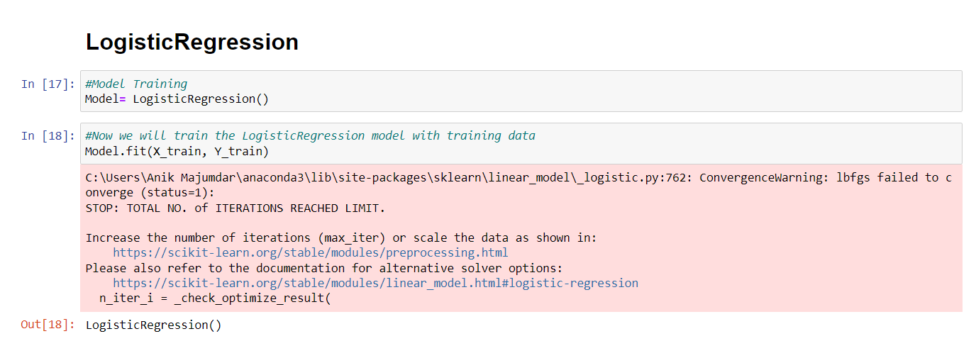
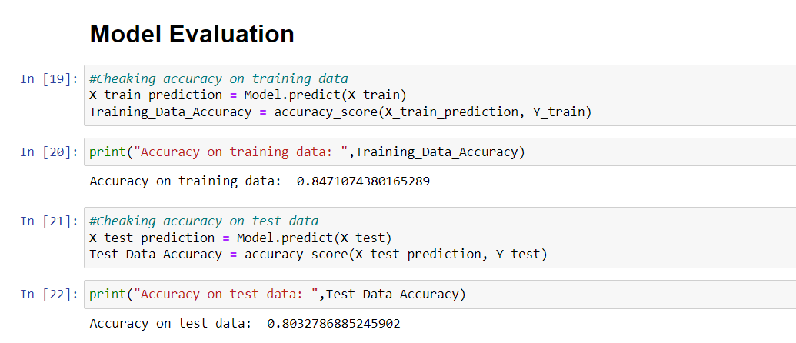
Model training and model evaluation
05

Slide 10
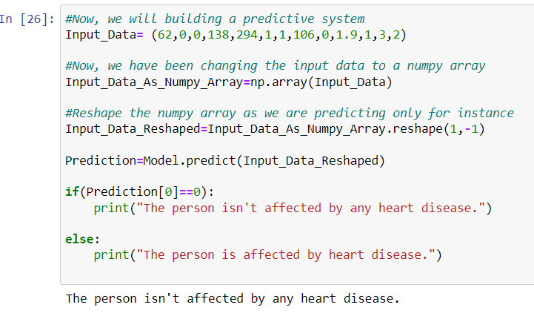
Building a predictive system and checking the results
06

Slide 11
Thank You

